Slide 1
AUTOMATIC DEPLOYMENT SYSTEM
Presenter: Mihir Bhavsar - 8022057037
Company Name: Parkar Digital
Role: Cloud Infrastructure Intern

Slide 2
TABLE OF CONTENTS
01
02
03
04
05
06
INTRODUCTION
OBJECTIVES
TECHNOLOGIES
ARCHITECURE DIAGRAM
ROADMAP
CHALLENGES

Slide 3
INTRODUCTION
What is Automatic Deployment?
- Automatic Deployment refers to the use of automation tools and cloud computing techniques to deploy applications or infrastructure with minimal manual intervention.
Why is it Important?
Efficiency: Reduces deployment time significantly.
Consistency: Ensures error-free deployments.
Scalability: Supports dynamic scaling of resources.
Cost-Effectiveness: Optimizes resource utilization, reducing costs.

Slide 4
OBJECTIVES
Faster Deployment: Automate the entire deployment process to save time and effort.
Scalability: Enable seamless scaling of resources to meet changing demands.
Cost Efficiency: Optimize cloud resources to minimize expenses.
Reliability: Ensure consistent and error-free deployments across all environments.

Slide 5
TECHNOLOGIES
Cloud Providers: AWS, Azure, Google Cloud Platform
Infrastructure as Code (IaC): Terraform, ARM Templates
CI/CD Tools: GitHub Actions, GitLab CI/CD
Configuration Management: Ansible
Monitoring & Logging: AWS CloudWatch, Grafana
Scripting and Automation: Python, Shell Scripting

Slide 6
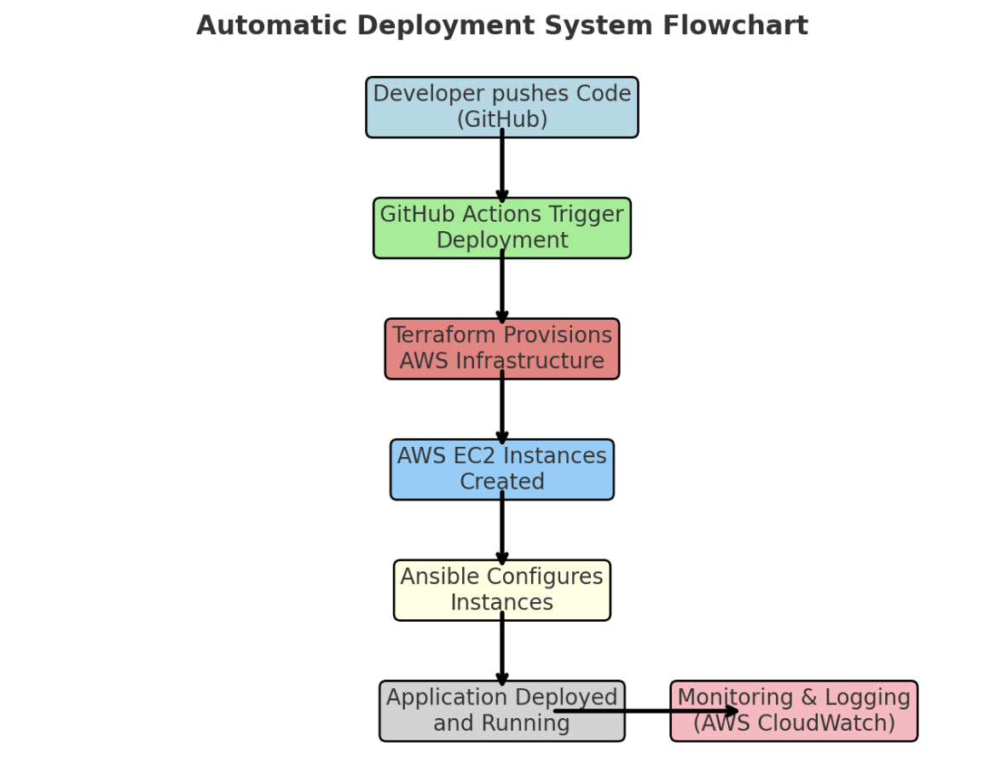
FLOW CHART

Slide 7
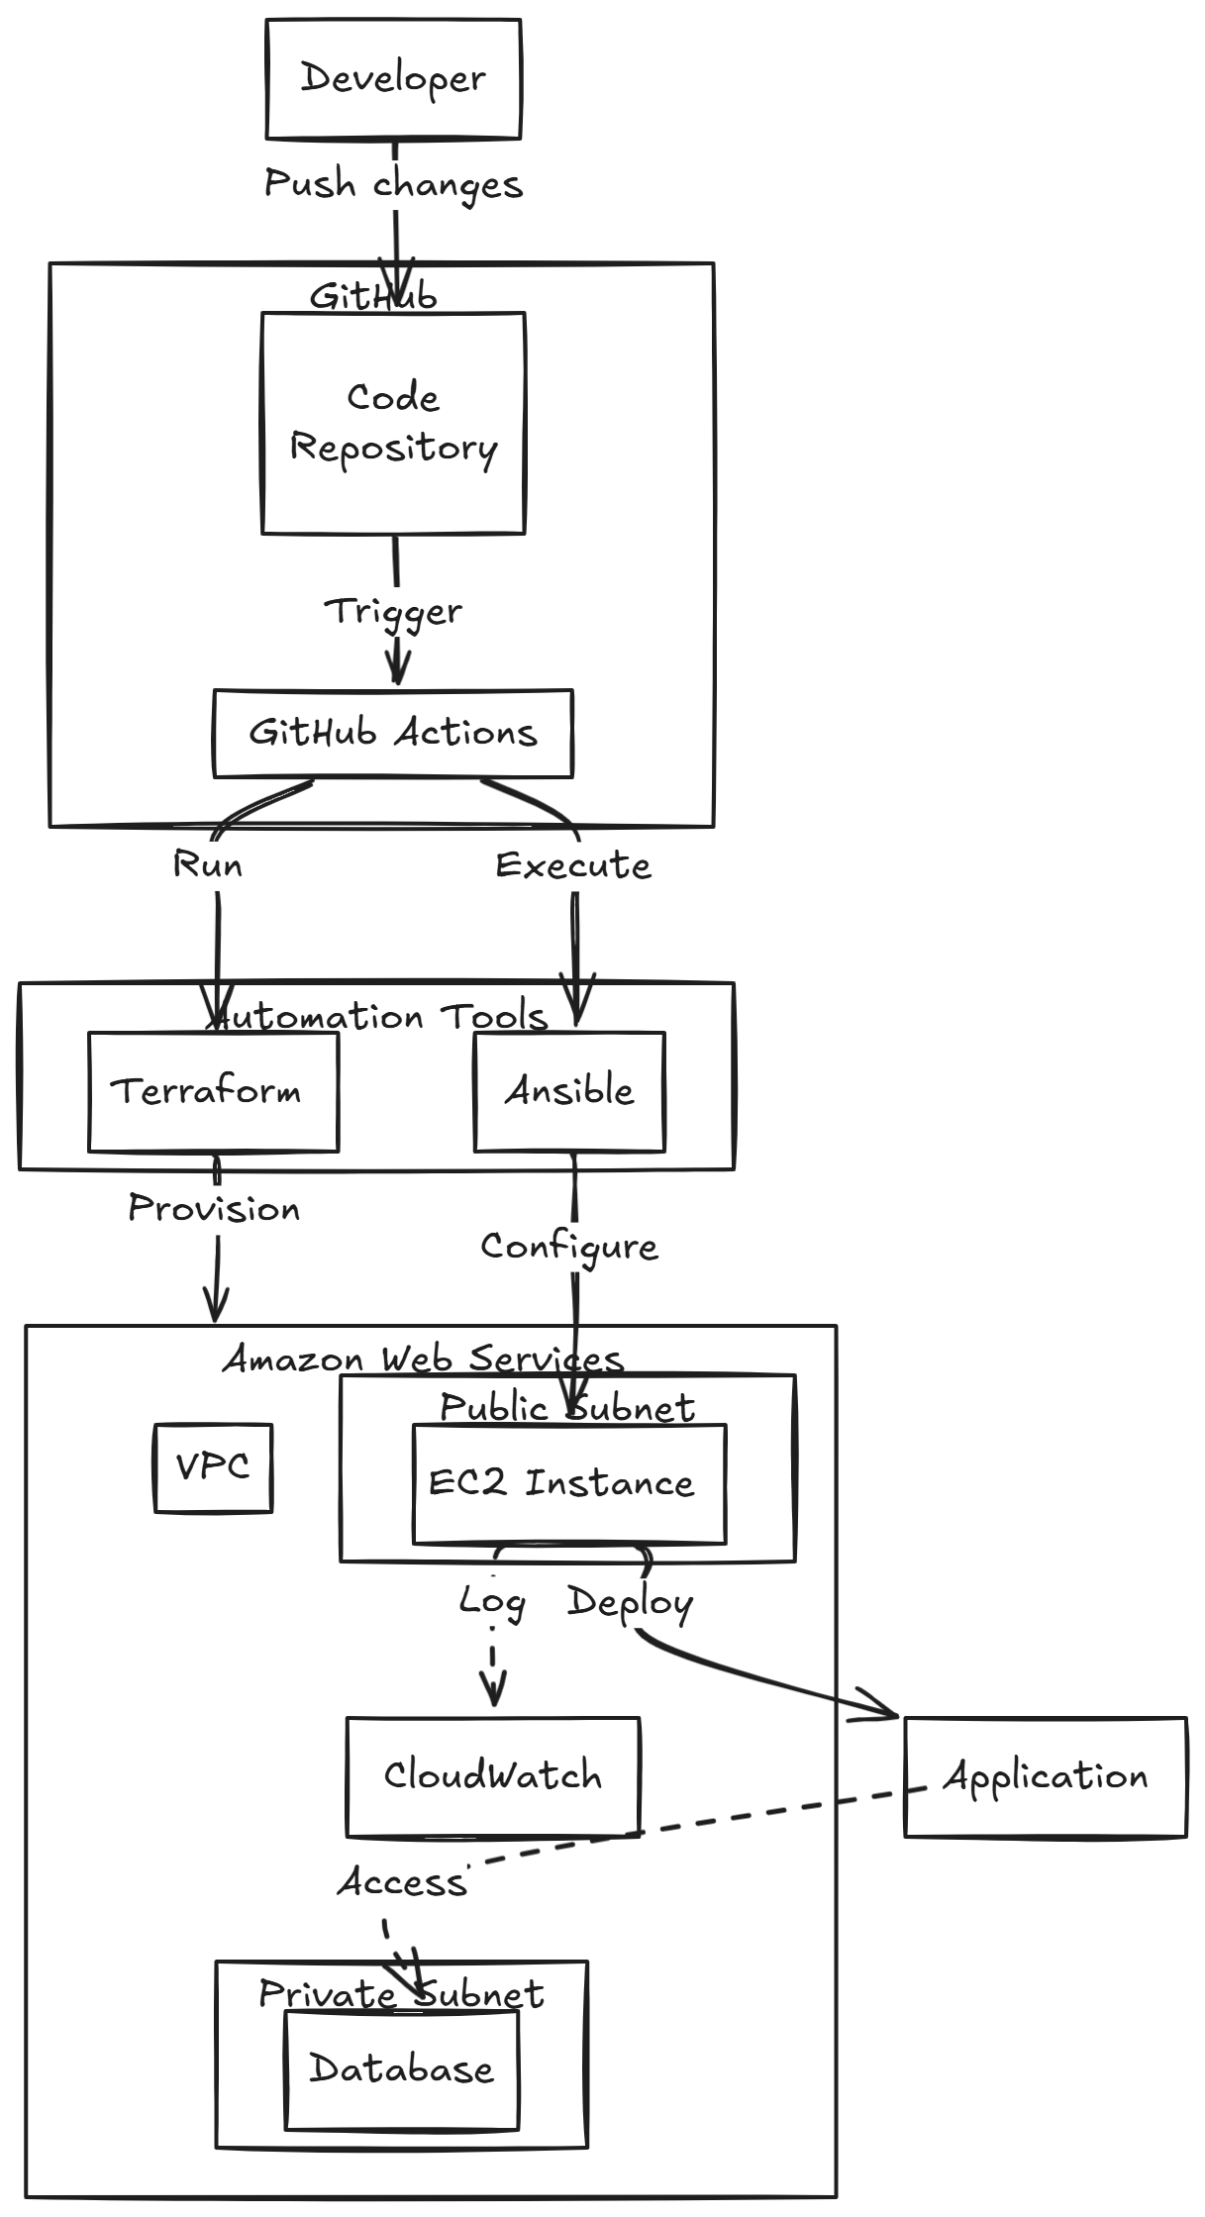
ARCHITECTURE DIAGRAM

Slide 8
ROADMAP
Requirement Analysis
Environment Setup
Infrastructure Automation
CI/CD Pipeline Design
Testing and Rollback Strategies
Monitoring and Optimization
Documentation

Slide 9
CHALLENGES
Security Concerns: Managing sensitive data and permissions securely.
Cost Optimization: Avoiding over-provisioning of cloud resources.
Complexity: Handling diverse technologies and environments.
Downtime Risks: Ensuring zero-downtime deployments during updates.

Slide 10
CONCLUSION
Expected Outcomes:
- Fully automated and reliable deployment system.
- Reduced manual efforts and faster deployment cycles.
- Improved scalability and cost-effectiveness.
Future Scope:
- Explore AI-driven optimizations for predictive scaling.
- Extend deployment automation to multi-cloud environments.

Slide 11
THANK YOU.

